Slide 1
Problem-Solving
Root Cause Analysis and Countermeasure Development
Notes:
NOTE: The Problem-Solving training module is intended for use either at kaizen event training or for general training about the Problem-Solving process. The training material is designed for events of any length, but typically, Problem-Solving events will span a full five days.
NOTE: There are several case studies/exercises that run through the body of this material. No separate handouts are required to complete these exercises, for all of the information is contained in the slides of this document. In order to facilitate the case study, answer slides have been inserted after each exercise slide. It is important to share with the class not to look beyond the exercise slide when completing the exercise. While many answers may be acceptable for the case study, the presentation will insert “textbook” answers for the purpose of carrying out the problem-solving process throughout the case study. Please affirm to the class that just because their answers may not match the presentation answers does not mean they are incorrect, however, for example purposes, we will reference the textbook answers throughout the presentation.

Slide 2

Other Modules In This Series:
5S
Standard Work
Total Productive Maintenance (TPM)
Administrative Lean
Cell Design/ Production Preparation Process (3P)
Kaizen
Kanban
Problem-Solving
Poka Yoke Quality Systems
Transaction Process Improvement (TPI)
Cause & Effect Diagram with the Additions of Cards (CEDAC)
Single Minute Exchange of Dies (SMED)
Value Stream Mapping (VSMi®)
Visual Management
Managing Daily Process Excellence
For More Information Please Contact:
Mark DeLuzio, President and CEO
+1.860.234.0915
mark.deluzio@leanhorizons.com
Strategically Creating Value Through the Elimination of Waste

Slide 3
This document contains confidential
and proprietary information owned
by Lean Horizons Consulting, LLC.
Any disclosure, use, copying or
distribution of this information without the express written consent of Lean Horizons Consulting is strictly prohibited.

Slide 4
Ground Rules for Event
Safety first (use personal protective equipment)
Active participation by all
Start and end on time
All electronic gadgets (phones, pagers, etc) turned to “off” or “silent”
Computers to be used only when instructed
Keep an open mind to change
Don’t let “perfect” get in the way of “better”
Notes:
DO: Ask the group if they have any ground rules to add (capture them on chart paper).
Ask the group if they agree to these ground rules.
DO: Perform Group Introductions

Slide 5
Goal of Problem-Solving Module
To provide you with the opportunity to apply problem-solving tools and processes that determine root cause and that are necessary to support continually improving processes
Introduction to
Problem-Solving
Problem
Solving Tools
Problem
Solving Process
Summary
Notes:
DO: Introduce the notion of Problem-Solving and the goal of this event.
SAY: “The major objectives of this module are that we want you to:
1 - Understand and utilize the customer-focused Problem-Solving Process
2 - Develop a working knowledge of how and when to use the basic tools to solve problems
3 - Improve the ability to creatively solve problems and initiate positive change”

Slide 6
Introduction to Problem-Solving
Introduction to
Problem-Solving
Problem-Solving Tools
Problem-Solving Process
Summary
Objectives:
Define Problem-Solving
Describe the Plan Do Check Act (PDCA) Model and Discuss the benefits of employing the full PDCA Cycle
List and define the steps of the Problem-Solving Process
List and define the common tools used in the Problem-Solving process
Notes:
DO: Review the Problem-Solving Tools that will be introduced in this section.

Slide 7
Problem-Solving
Introduction to Problem-Solving
Definition
Purpose
Examples
The ability to permanently eliminate problems at the root cause level using a systematic approach and specific Problem-Solving tools.
To address and rectify issues that prevent systems, processes, or individuals from achieving the standard that has been set for optimal performance and outcomes.
Problem: You sometimes don’t pay bills on time, incurring late fees.
Solution: Set up automated payments for your regular bills or use a digital calendar to set reminders a few days before each bill is due.
Problem: You frequently misplace your keys and waste time looking for them.
Solution: Install a key hook near the garage door. This way, you can hang your keys as soon as you enter the house, ensuring they are always in the same spot when you need them.
"What makes a world-class company is their ability to solve problems. Even the great Toyota has problems...but we 'solve' our problems only once." - Toyota Executive - 1990

Slide 8
Problem-Solving Process
LHC Problem-Solving Process
Determine Root Causes
Develop
Problem Statement(s)
9
Determine
Type 0-1-2
5
1
Objective Not Met
Monitor Countermeasure Effectiveness via KPIs
13
Develop Countermeasures
Develop
Objectives and Timeframes
10
Select Cross Functional Team
6
2
Objective Met
Freeze Standard
Incorporate Into
Daily Management
14
Identify
Customer - Supplier Relationships
7
Develop Action Plan
Collect Data
11
3
Continue Kaizen
Analyze Data
4
Temporary Countermeasures
(If Needed)
8
Execute Action Plan
& Document New Process
12
Key:
Plan
Do
Check
Act

Slide 9
Plan Do Check Act (PDCA)
Plan
Act
Do
Check
Involves identifying a problem or opportunity for improvement, setting objectives, and developing a detailed plan to achieve these objectives. This includes collecting data, analyzing the current situation, identifying root causes, and formulating potential solutions.
Where necessary adjustments based on the evaluation results from the "Check" phase are made. This may involve refining the plan, implementing successful changes on a larger scale, or starting the PDCA cycle again to address other issues.
The implementation stage, where the planned actions are executed. This involves putting the plan into action on a small scale to test its effectiveness and gather data on its impact.
Involves evaluating the results of the implemented actions against the objectives set in the "Plan" phase. This includes analyzing data, reviewing outcomes, and comparing them to the expected results to determine if the changes are effective.

Slide 10
Problem-Solving Tools
Introduction to
Problem-Solving
Problem-Solving Tools
Problem-Solving Process
Summary
Objectives:
Overview:
  Define Fishbone, 5 Why, and Pareto Chart Analysis.
Fishbone Analysis:
  Explain when and how to use Fishbone Analysis.
  List the 6-M’s and construct a Fishbone Diagram.
5 Why Analysis:
  Explain the 5 Why Analysis process.
  Highlight the importance of the problem statement.
Pareto Chart Analysis:
  Use Pareto Analysis to prioritize problems.
  Focus on key problem areas using Pareto Analysis.
Notes:
DO: Review the Problem-Solving Tools that will be introduced in this section.

Slide 11

Overview of Problem-Solving Tools
Problem-Solving Tools
There are many Problem-Solving Tools designed to help you identify and drive to Root Cause. This module will focus on 3 of the most common and effective tools used daily to solve problems.
  Fishbone Analysis
  5 Why Analysis
  Pareto Analysis

Slide 12
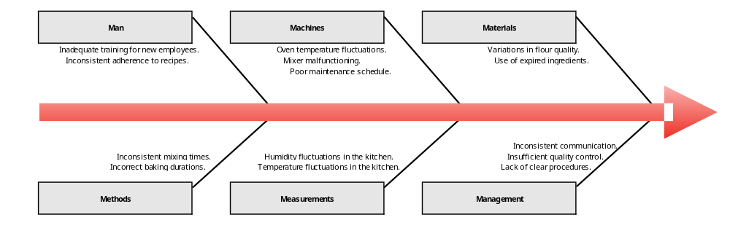
Fishbone Analysis
Problem-Solving Tools
Fishbone Analysis
Fishbone Diagram
A visual tool used to systematically identify and analyze the root causes of a problem. It helps to organize potential causes into categories, making it easier to pinpoint the source of an issue.
  “Head” of the fish: The problem.
  “Bones” of the fish: Major categories of potential causes (6Ms: Methods, Materials, Man, Machines, Measurements, Management)
  “Sub-Bones” of the fish: Specific causes within each category.
Notes:
Say:

Slide 13
5 Whys
Problem-Solving Tools
5 Whys
The 5 Whys Analysis is a problem-solving tool used to identify the root cause of a problem by repeatedly asking "Why?" until the underlying cause is discovered.
The car won’t start.
The battery is dead.
Why is the battery dead?
The alternator is not charging the battery.
Why is the alternator not charging the battery?
The alternator belt is broken.
Why is the alternator belt broken?
The belt is beyond its useful service life and hasn’t been replaced.
Why was the alternator belt not replaced?
The car was not maintained according to the service schedule.
Root cause: the car was not maintained according to the service schedule.
Why won’t the car start?
Problem
Root Cause
Why #1
Why #2
Why #3
Why #4
Why #5
Notes:
Say:

Slide 14
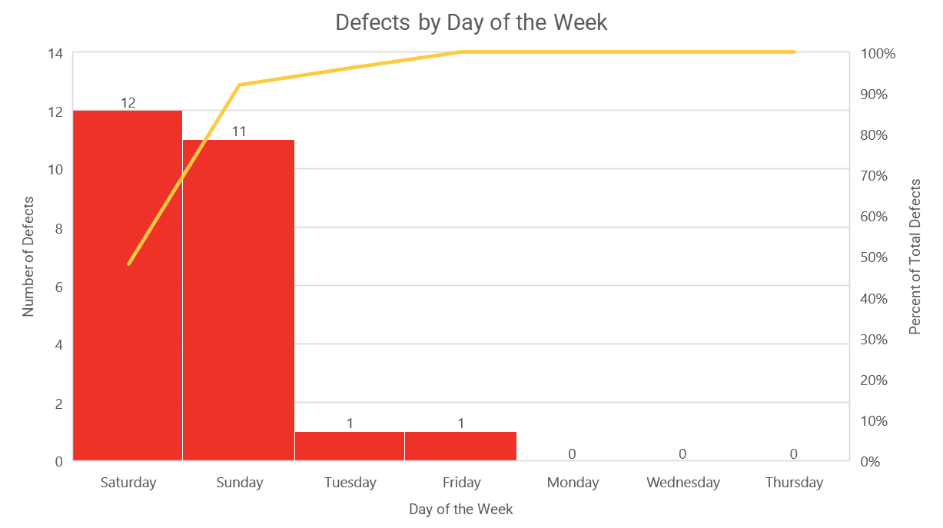
Pareto Chart Analysis
Problem-Solving Tools
Pareto Chart Analysis
Pareto Chart
A graphical tool used to prioritize problems or causes by identifying the most significant factors. It is based on the Pareto Principle (80/20 rule), which suggests that roughly 80% of problems are caused by 20% of the causes. The chart helps focus efforts on the most impactful areas.
Pareto Chart Structure:
  Bars: Represent the frequency or impact of problems or causes.
  Line Graph: Shows the cumulative percentage of the total impact.
Notes:
Say:

Slide 15
Problem-Solving Process
Introduction to
Problem-Solving
Problem-Solving Tools
Problem-Solving Process
Summary
Objectives:
Identify and Categorize: Understand and categorize the problem type (Type 0, 1, or 2)
Team Formation: Form an effective cross-functional team
Data Handling: Collect, analyze, and utilize data to gain insights and develop problem statements
Goal Setting: Establish specific objectives and timeframes
Relationship Mapping: Identify key customer-supplier relationships
Implement and Analyze: Implement temporary countermeasures, determine root causes, and develop action plans
Execute and Monitor: Execute action plans, document processes, train staff, and monitor effectiveness via KPIs
Standardize and Improve: Freeze the new standard, integrate it into daily management, and promote continuous improvement (Kaizen)
Notes:
DO: Review the Problem-Solving Process that will be introduced in this section.

Slide 16
Problem-Solving Process
LHC Problem-Solving Process
Determine Root Causes
Develop
Problem Statement(s)
9
Determine
Type 0-1-2
5
1
Objective Not Met
Monitor Countermeasure Effectiveness via KPIs
13
Develop Countermeasures
Develop
Objectives and Timeframes
10
Select Cross Functional Team
6
2
Objective Met
Freeze Standard
Incorporate Into
Daily Management
14
Identify
Customer - Supplier Relationships
7
Develop Action Plan
Collect Data
11
3
Continue Kaizen
Analyze Data
4
Temporary Countermeasures
(If Needed)
8
Execute Action Plan
& Document New Process
12
Key:
Plan
Do
Check
Act

Slide 17
Problem-Solving Process
LHC Problem-Solving Process
Determine Root Causes
Develop
Problem Statement(s)
9
Determine
Type 0-1-2
5
1
Objective Not Met
Monitor Countermeasure Effectiveness via KPIs
13
Develop Countermeasures
Develop
Objectives and Timeframes
10
Select Cross Functional Team
6
2
Objective Met
Freeze Standard
Incorporate Into
Daily Management
14
Identify
Customer - Supplier Relationships
7
Develop Action Plan
Collect Data
11
3
Continue Kaizen
Analyze Data
4
Temporary Countermeasures
(If Needed)
8
Execute Action Plan
& Document New Process
12
Key:
Plan
Do
Check
Act

Slide 18
1. Determine Type 0-1-2 Problem
Problem-Solving Process
Definition
Purpose
Examples
A categorization of the problem based on the status of applicable standards.
Identifying the problem type helps tailor the problem-solving approach for maximum effectiveness.
To establish a starting point for problem resolution by identifying the current state of process standards.
Type 0: No training manual exists for a new machine – create one.
Type 1: Operators trained on the machine but still making errors – reinforce training or improve the standard.
Type 2: Operators are following the standard but not achieving the desired results.
Notes:
Ask:

Slide 19
1. Determine Type 0-1-2 Problem
Problem-Solving Process
0 – No Standard Exists
1 – Standard Exists But Not Being Followed
2 – Standard Exists But Not Delivering Desired Results
No documentation exists for a process
Everyone has their own way of doing the process
Process relies on “Tribal Knowledge”
Example: At home, shoes are scattered by the front door because there is no designated shoe storage or rack.
People who created the standard weren’t the people who use it in practice
Poor discipline
Documentation exists but is inaccessible to operators
Example: The family car has a maintenance schedule sticker on the windshield, but oil changes and tire rotations are not performed on time, leading to performance issues.
Standard is followed
Doesn’t provide intended results
People who created the standard weren’t the people who use it in practice
Example: The local coffee shop has a standard for making lattes in under one minute to ensure quick service, but this often results in lukewarm beverages due to insufficient processing standard.
Notes:
Ask: Why would you have a standard that isn’t being followed?
Coffee example:
In trying to provide quick DELIVERY and service, we’re compromising QUALITY by creating a standard that does not provide us with a quality product.
SQDC: Prioritizing D over Q.

Slide 20
When to Use Problem-Solving
Introduction to Problem-Solving
Use problem-solving when there is a deviation from the desired standard, and the cause is unknown.
Desired Standard
Deviation = Problem
Solution/Kaizen
Established Standard
Deviation = Problem
Solution/Kaizen
Actual Performance
Notes:
Actual performance is below the established standard.
Established standard isn’t good enough because customer desires/demands something more.

Slide 21
Problem-Solving Process
LHC Problem-Solving Process
Determine Root Causes
Develop
Problem Statement(s)
9
Determine
Type 0-1-2
5
1
Objective Not Met
Monitor Countermeasure Effectiveness via KPIs
13
Develop Countermeasures
Develop
Objectives and Timeframes
10
Select Cross Functional Team
6
2
Objective Met
Freeze Standard
Incorporate Into
Daily Management
14
Identify
Customer - Supplier Relationships
7
Develop Action Plan
Collect Data
11
3
Continue Kaizen
Analyze Data
4
Temporary Countermeasures
(If Needed)
8
Execute Action Plan
& Document New Process
12
Key:
Plan
Do
Check
Act

Slide 22
2. Select Cross-Functional Team
Problem-Solving Process
Definition
Purpose
Examples
A diverse group of individuals from different departments and skill sets relevant to the problem.
It is sometimes helpful to include team members who are totally disassociated with the problem.
It is sometimes helpful to include representatives from your customer and/or supplier base.
To ensure diverse expertise and viewpoints are represented, which can lead to more innovative and comprehensive solutions.
It is essential to involve the people who are closest to the problem as team members.
A product defect might involve team members from manufacturing, quality assurance, sales, accounting, purchasing, and design engineering.
Implementing a new IT system may require IT specialists, end-users from finance, and shop-floor workers.
Notes:
Ask:
Why is it important to have a cross-functional team?
Why is it important to have team members who are disassociated with the problem?

Slide 23
Case Study: Operator Insight Leads to Breakthrough at West Instruments
Problem-Solving Process
Problem Overview:
  West Instruments faced intermittent failures in temperature controller tests.
Initial Challenges:
  Engineers and executives tried and failed to diagnose the cause due to the random nature of test failures.
Operator Involvement:
  Inclusion of operators in a Kaizen event revealed the issue never occurred on weekends.
Discovery and Solution:
  Investigation led to the discovery of Electronic Magnetic Interference (EMI) from a neighboring factory affecting tests.
  Solution: Installed a copper shield around testing equipment.
Key Takeaway:
Involving those closest to the problem can uncover insights that are not apparent to others.

Slide 24
Problem-Solving Process
LHC Problem-Solving Process
Determine Root Causes
Develop
Problem Statement(s)
9
Determine
Type 0-1-2
5
1
Objective Not Met
Monitor Countermeasure Effectiveness via KPIs
13
Develop Countermeasures
Develop
Objectives and Timeframes
10
Select Cross Functional Team
6
2
Objective Met
Freeze Standard
Incorporate Into
Daily Management
14
Identify
Customer - Supplier Relationships
7
Develop Action Plan
Collect Data
11
3
Continue Kaizen
Analyze Data
4
Temporary Countermeasures
(If Needed)
8
Execute Action Plan
& Document New Process
12
Key:
Plan
Do
Check
Act

Slide 25
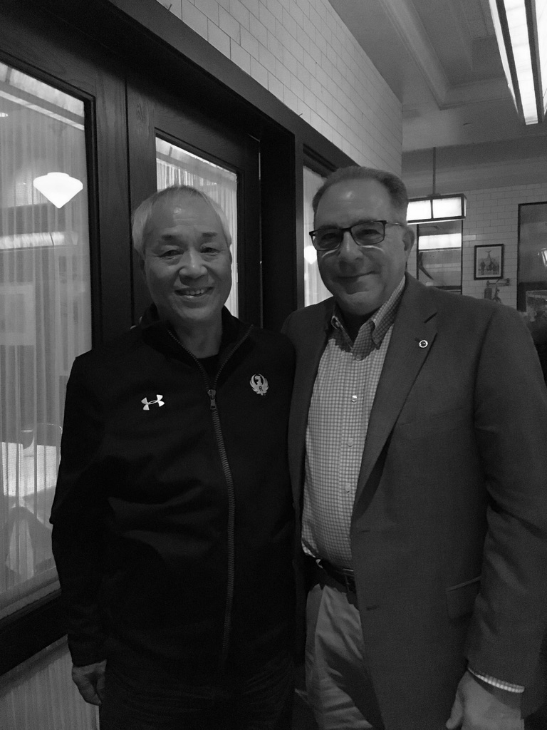

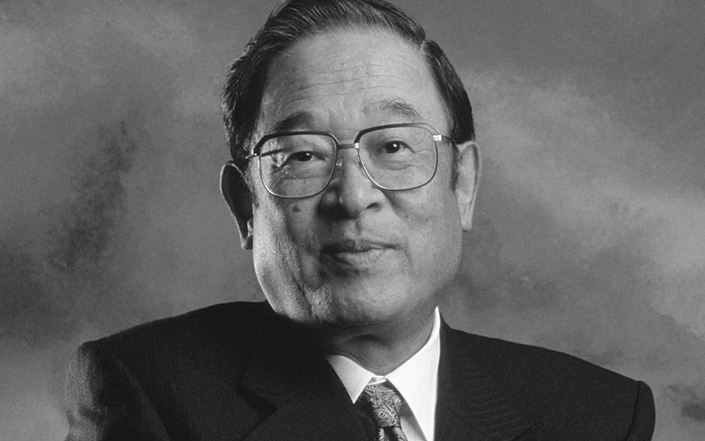
Wisdom from Toyota’s Pioneers- Perspectives on Problem Solving
Three Keys to Leadership:
Go See
Ask Why
Show Respect
- Fujio Cho
Chairman (ret), Toyota
“DeLuzio-San, stop asking questions. They are only going to lie to you! Your eyes will not lie to you!”
Chihiro Nakao
Shingijutsu
“Toyota would not let one opine on a problem they have not observed firsthand.”
John Shook
NUMMI Initial Hire

Slide 26

Records Example
Problem-Solving Process
Do you believe your own data?

Slide 27
3. Collect Data
Problem-Solving Process
Definition
Purpose
Examples
Relevant quantitative and qualitative information that provides insights into the problem.
To gather evidence about the problem to understand its magnitude, impact, and characteristics.
Collecting defect rates from the production line to identify trends.
Surveying employees for feedback on a new process.
Notes:
Ask:

Slide 28
Common Data Collection Tools
Problem-Solving Process
Data Collection Tools (Box 3)
Analytical Tools (Box 4)
Check Sheet (quantitative)
Surveys (quantitative/qualitative)
Direct Observations (qualitative)
Interviews (qualitative)
Records (qualitative)
Run Chart
Pareto Chart
Histogram
Fishbone Diagram

Slide 29
Check Sheet
Problem-Solving Process
Definition
Purpose
Examples
A structured, pre-formatted document used to collect data.
To enable an organized collection of data, which will subsequently be fed into analytical tools (Step 4).
Manufacturing Defects: Used to track the occurrence of different types of defects.
Hospital Infections: Used to record instances of infection in different wards.
Order Quotations: Used to record reasons for losing RFQs.
Customer Service: Used to record the type of customer complaints by date.
Notes:
Ask:

Slide 30
Check Sheet Example
Problem-Solving Process
Days Defect Type | Monday | Tuesday | Wednesday | Thursday | Friday | Saturday | Sunday | Total
Overcooked Cakes |  |  |  |  | / | //// | //// | 9
Undercooked Cakes |  |  |  |  |  | // | //// | 7
Incorrect Frosting |  | / |  |  |  | // | / | 4
Uneven Layers |  |  |  |  |  | /// | // | 5
Total | 0 | 1 | 0 | 0 | 1 | 11 | 12 | 25
What is your takeaway from this example?
Notes:
Daily Counts of Defect Types Over a Week
The Check Sheet tracks the occurrence of specific types of cake defects each day. Rows represent different defect types (e.g., overcooked cakes, undercooked cakes, incorrect frosting, uneven layers), while columns represent days of the week. Tally marks are used to indicate the number of defects recorded each day. The total row sums the defects for each day, and the total column sums defects by type. This tool helps the end user identify patterns in defect occurrence over time.

Slide 31
Surveys
Problem-Solving Process
Definition
Purpose
Examples
A structured, pre-formatted document used to collect data.
To enable an organized collection of data, which will subsequently be fed into analytical tools (Step 4).
Manufacturing Defects: Used to track the occurrence of different types of defects.
Hospital Infections: Used to record instances of infection in different wards.
Order Quotations: Used to record reasons for losing RFQs.
Customer Service: Used to record the type of customer complaints by date.
Notes:
Ask:

Slide 32
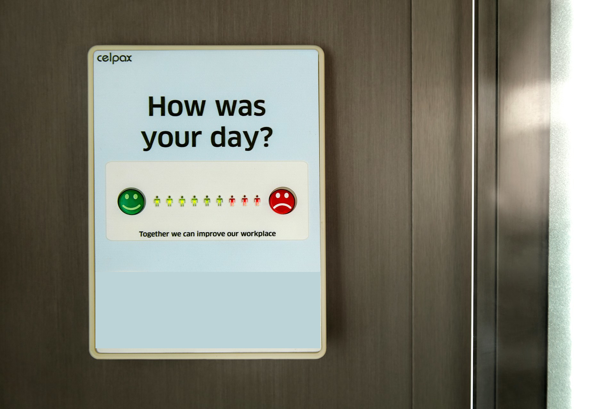
Surveys Example
Problem-Solving Process
What is your takeaway from this example?

Slide 33
Direct Observations
Problem-Solving Process
Definition
Purpose
Examples
A structured, pre-formatted document used to collect data.
To enable an organized collection of data, which will subsequently be fed into analytical tools (Step 4).
Manufacturing Defects: Used to track the occurrence of different types of defects.
Hospital Infections: Used to record instances of infection in different wards.
Order Quotations: Used to record reasons for losing RFQs.
Customer Service: Used to record the type of customer complaints by date.
Notes:
Ask:

Slide 34

Direct Observations Example
Problem-Solving Process
What is your takeaway from this example?

Slide 35
Interviews
Problem-Solving Process
Definition
Purpose
Examples
A structured, pre-formatted document used to collect data.
To enable an organized collection of data, which will subsequently be fed into analytical tools (Step 4).
Manufacturing Defects: Used to track the occurrence of different types of defects.
Hospital Infections: Used to record instances of infection in different wards.
Order Quotations: Used to record reasons for losing RFQs.
Customer Service: Used to record the type of customer complaints by date.
Notes:
Ask:

Slide 36

Interviews Example
Problem-Solving Process
What is your takeaway from this example?

Slide 37
Records
Problem-Solving Process
Definition
Purpose
Examples
A structured, pre-formatted document used to collect data.
To enable an organized collection of data, which will subsequently be fed into analytical tools (Step 4).
Manufacturing Defects: Used to track the occurrence of different types of defects.
Hospital Infections: Used to record instances of infection in different wards.
Order Quotations: Used to record reasons for losing RFQs.
Customer Service: Used to record the type of customer complaints by date.
Notes:
Ask:

Slide 38
Qualitative Data
Problem-Solving Process
Definition
Purpose
Examples
Non-numerical information that captures descriptive attributes, qualities, or characteristics of subjects or phenomena.
This type of data is usually text-based and gathered through observations, interviews, or open-ended questions where the responses are complex and detailed.
To provide depth and context to understand the "how" and "why" behind specific trends or behaviors.
Ohno Circle:
  An individual stands in a predefined circle on the production floor without moving and observes and makes notes on a specific process or workflow for an extended period.
Interviews:
  Involves asking open-ended questions to get comprehensive, in-depth responses from participants.
Customer Feedback:
  Customers are asked open-ended questions about what they liked or disliked about the store layout, product variety, and customer service.
“You can observe a lot just by watching” – Yogi Berra
Notes:
Ask: What do you gain by gathering qualitative data as shown in the examples?
Ohno Circle:
Provides an understanding of the reality of the work floor, identify inefficiencies, and generate insights for process improvements.
Interviews:
Interviews are used to explore complex issues, gather personal stories or expert insights, and understand motivations, feelings, and decisions. In a business context, they can help uncover customer needs, employee satisfaction, or market trends.
Customer Feedback:
Helps the store management understand customer preferences and areas needing improvement to enhance the overall shopping experience.

Slide 39
Qualitative vs. Quantitative
Problem-Solving Process
Qualitative | Quantitative
It is hot | It is 100°F
Quality is poor | First-pass yield has decreased from 90% to 60%
Customers are not happy | Customer complaints have increased by 127% during the last month
Morale is low | Employee turnover is 46%

Slide 40
Problem-Solving Process
LHC Problem-Solving Process
Determine Root Causes
Develop
Problem Statement(s)
9
Determine
Type 0-1-2
5
1
Objective Not Met
Monitor Countermeasure Effectiveness via KPIs
13
Develop Countermeasures
Develop
Objectives and Timeframes
10
Select Cross Functional Team
6
2
Objective Met
Freeze Standard
Incorporate Into
Daily Management
14
Identify
Customer - Supplier Relationships
7
Develop Action Plan
Collect Data
11
3
Continue Kaizen
Analyze Data
4
Temporary Countermeasures
(If Needed)
8
Execute Action Plan
& Document New Process
12
Key:
Plan
Do
Check
Act

Slide 41
4. Analyze Data
Problem-Solving Process
Definition
Purpose
Examples
The process of examining data to extract meaningful patterns and trends.
Common Tools:
  Pareto
  Histogram
  Run Chart
  Fishbone
  5 Whys
To interpret the collected data to identify patterns, trends, and anomalies that can lead to actionable insights.
Analyze data that is necessary to create an effective problem statement (Step 5).
Using Pareto charts to identify the most common type of production defects.
Analyzing customer service call logs to pinpoint frequent customer issues.
Analyzing the frequency of downtime hours by machine.
Notes:
Ask:

Slide 42
Pareto Diagram
Problem-Solving Process
Definition
Purpose
Examples
A type of bar chart that displays the frequency of occurrences by category, ordered from highest to lowest.
Based on the Pareto principle (also known as the 80/20 rule), which suggests that roughly 80% of the effects come from 20% of the causes.
Helps focus efforts on the areas that will have the greatest impact on improving a system.
Customer Complaints in a Call Center:
  Analyzing types of customer complaints received.
Software Bug Tracking:
  Categorizing types of bugs reported in a software development project.
Lost Sales Quotes:
  Can be tracked by customer, salesman, product, region, etc.
Immigration Data:
  Track by country, gender, religion, etc.
Notes:
Ask:

Slide 43
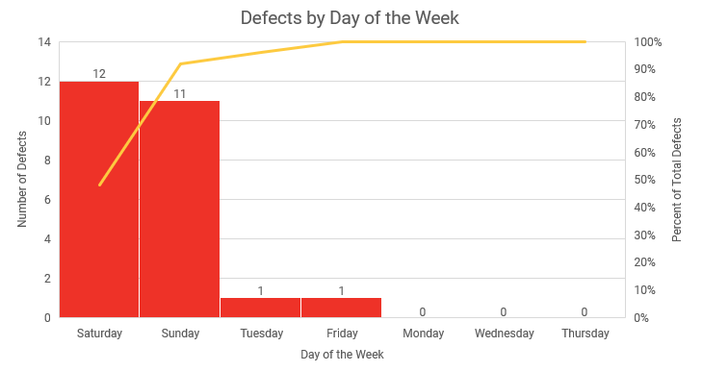
Pareto Diagram Example
Problem-Solving Process
What is your takeaway from this example?
Notes:
Defects by day of the week
The Pareto Diagram illustrates the frequency of cake defects occurring on different days of the week. The X-axis represents each day of the week, ordered from highest to lowest number of defects. The Y-axis on the left shows the number of defects, while the Y-axis on the right shows the cumulative percentage of defects. Bars represent the count of defects for each day, with a line graph superimposed to show the cumulative percentage. This chart helps the end user identify which days are contributing most to the defects, highlighting the "vital few" days that need the most attention.

Slide 44
Histogram
Problem-Solving Process
Definition
Purpose
Examples
A type of bar chart that shows how often something happens within different ranges or groups, known as bins.
Each bin represents a range of data, and the height of the bar shows how many times data within that range occurs.
To give a clear picture of how data is spread out.
It helps you see which groups are more common and whether the data clusters around certain values.
This makes it easier to get a quick understanding of the data’s overall pattern and variability.
Employee Performance Ratings:
  Analyzing how many employees fall into different performance categories over the year.
Hourly Sales Per Day:
  Examining the number of sales transactions that occur throughout the day.
Quality Inspection Defects:
  Tracking when defects occur throughout the day.
Notes:
Ask:

Slide 45
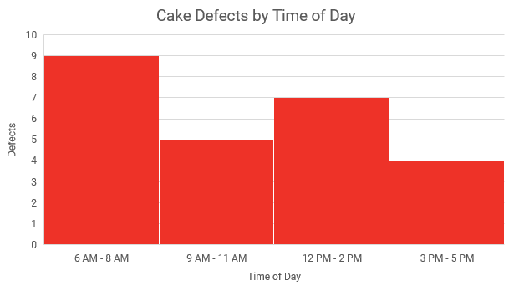
Histogram Example
Problem-Solving Process
What is your takeaway from this example?
Notes:
Distribution of defective cakes by time of day
The Histogram shows the frequency of cake defects occurring at different times of the day. The X-axis represents the time of day, divided into hourly intervals from 6:00 AM to 4:00 PM. The Y-axis shows the number of defects recorded during each time interval. Bars represent the count of defects for each hour, helping to identify peak times when defects are more likely to occur. This visualization helps the end user understand which times of the day are most problematic, providing insight into potential adjustments in processes or staffing.

Slide 46
Run Chart
Problem-Solving Process
Definition
Purpose
Examples
A line graph that displays data points plotted over time.
To provide a visual analysis of variations in a process over time, helping to understand the stability and predictability of the process.
Spots trends, cycles, patterns, and unusual observations for further investigation.
Temperature Monitoring:
  Monitor the daily high temperature in a greenhouse over a month.
Customer Call Volume:
  Tracking the number of customer service calls a help center receives daily.
Emergency Room Traffic:
  Tracking the number of incoming patients by day and by hour.
Notes:
Ask:

Slide 47
Run Chart Example
Problem-Solving Process
What is your takeaway from this example?
Notes:
Number of defective cakes per day over a month
The Run Chart plots the daily count of defective cakes over a month. The X-axis represents the days of the month, and the Y-axis represents the number of defective cakes. Each point on the chart corresponds to the number of defects on a specific day, and a line connects these points to show the trend over time. This visualization helps the end user identify trends, fluctuations, and periods with high or low defect rates and assess the impact of corrective actions.

Slide 48
Fishbone Diagram (Cause-And-Effect)
Problem-Solving Process
Definition
Purpose
Examples
A fishbone diagram proves a structured way of looking at the cause-and-effect nature of problems.
Provides a mechanism for teams to identify and explore all possible causes related to a problem.
6 M’s
  Machines
  Materials
  Methods
  Manpower
  Measurement
  Mother Nature
Other commonly used categories
  Policies, procedures, people and plant when dealing with administrative areas
Notes:
Say: These examples are not all-inclusive. Use what’s appropriate for the situation.

Slide 49
Fishbone Diagram Example
Problem-Solving Process
What is your takeaway from this example?
Notes:
Potential causes of high defect rate in baking cakes
The Fishbone Diagram categorizes and displays various factors that might contribute to the problem of defective cakes. These factors are grouped into categories such as Man, Machines, Materials, Methods, Measurements, and Management. Each category branches out into specific causes, such as inadequate training for employees or oven temperature fluctuations. This visual tool helps the end user systematically explore all possible root causes of the defect issue.

Slide 50
5 Whys
Problem-Solving Process
Definition
Purpose
Examples
A root cause analysis method that involves asking "Why?" five times, or as many times as necessary, to peel away the layers of symptoms and reach the underlying cause of a problem.
Must be used in conjunction with other Problem-Solving tools
Must have a well-defined problem statement in order to effectively focus the analysis and arrive at the correct root cause.
To systematically drill down into a problem's details and circumstances to ensure that any corrective actions address the fundamental reasons for the issue rather than merely treating its superficial symptoms.
5 Whys help you discover:
  Why the error was made.
  Why the problem happened.
  Why the system failed.
  Why it takes so long.
  Why the error keeps happening.
  Why the error wasn’t detected.
Notes:
Say:
5 Whys are used after potential causes are identified (using other tools such as Pareto or Fishbone Analysis) in order to drill to the root cause.
Symptoms are the part we see, the part on the surface; they are how we know we have a problem.
Problems are the cause of that symptom.

Slide 51

Problem:
The Washington Monument is Disintegrating
Problem-Solving Process
Why is the Washington Monument disintegrating?
  The monument is being cleaned with harsh chemicals.
Why is it frequently cleaned with harsh chemicals?
  There is a lot of pigeon poop on the monument.
Why are there a lot of pigeons around the monument?
  Pigeons eat spiders nesting in the monument.
Why are there spiders inside the monument?
  The spiders are nesting inside the monument to catch gnats.
Why are there gnats around the monument?
  The gnats are attracted to artificial light at dusk.
Root Cause:
The artificial light at dusk attracts gnats, which in turn attracts spiders, which then attract pigeons. The pigeon poop causes frequent cleaning with harsh chemicals, leading to the disintegration of the monument.
Possible Solution:
Adjust or reduce the use of artificial lighting at dusk to reduce the attraction of gnats, thereby breaking the chain reaction that ultimately leads to the monument’s disintegration.
Notes:
Ask: Do you think that this problem was solved by one person?

Slide 52
Problem-Solving Process
LHC Problem-Solving Process
Determine Root Causes
Develop
Problem Statement(s)
9
Determine
Type 0-1-2
5
1
Objective Not Met
Monitor Countermeasure Effectiveness via KPIs
13
Develop Countermeasures
Develop
Objectives and Timeframes
10
Select Cross Functional Team
6
2
Objective Met
Freeze Standard
Incorporate Into
Daily Management
14
Identify
Customer - Supplier Relationships
7
Develop Action Plan
Collect Data
11
3
Continue Kaizen
Analyze Data
4
Temporary Countermeasures
(If Needed)
8
Execute Action Plan
& Document New Process
12
Key:
Plan
Do
Check
Act

Slide 53
5. Develop Problem Statement(s)
Problem-Solving Process
Definition
Purpose
Examples
A clear, concise, and specific description of an issue, highlighting its impact on a process or the business. It is based on data, quantifiable, and avoids embedding solutions or perceived root causes.
To clearly define the issue at hand, ensuring that efforts are focused on solving a single, well-defined problem. This helps prevent scope creep and ensures that solutions are targeted and effective.
By being data-driven and specific, problem statements provide a solid foundation for further analysis and problem-solving efforts.
Manufacturing Defects:
  The defect rate for the Model X component increased from 1% to 5% from January to March 2024, impacting overall product quality and leading to an estimated increase in rework costs of $10,000 per month.
Customer Service Issues:
  Customer complaints about delivery delays have risen by 20% between September 2023 to January 2024, resulting in a 15% decrease in customer satisfaction scores and a potential loss of $50,000 in repeat business.
Operational Efficiency:
  The average processing time for purchase orders has increased from 2 days to 5 days from May to November 2023, causing delays in project timelines and reducing operational efficiency by 30%.
Notes:
Ask: Why do you think we said “problem statements” instead of “problem statement”?
There can be more than one problem that needs to be solved.
Each problem requires its own problem statement.

Slide 54
Developing Problem Statement
Problem-Solving Process
Develop a very focused and specific statement that describes and quantifies the unsatisfactory situation.
Keep the statement simple.
Be sure the statement has impact.
Can anyone clearly understand the unacceptable condition?
Answer Who, What, Where, When
  Who is affected?
  What is (are) the negative outcome(s) being experienced?
  Where is it happening?
  When does it occur?
  (Do not ask “Why is it happening?” at this time)
Notes:
SAY: “Define the problem statement using historical references, and quantitative, actual data.”
SAY: “We need to be conscious of the full range of conditions under which the problem occur (want to make sure we have a full representative sample in our data).

Slide 55
Examples of Problem Definition
Problem-Solving Process
Be sure not to be too vague…
  “Customer Satisfaction is at an unacceptable level”
Rather…
  “Customer Satisfaction scores have fallen below 95% at store 127 during March 2024”
Be sure you don’t address multiple problems…
  “Employee turnover in the warehouse is up 28% over last year, causing inventory accuracy to slip below 73%”
Rather…
  Problem 1: “Employee turnover is up 28% vs. last year”
  Problem 2: “Inventory accuracy has fallen below 73% vs. last year”

Slide 56
Metric Characteristics
Problem-Solving Process
Provide an objective measure of the “health” of a process and give clear direction for Problem-Solving.
  Personal health measures: weight, blood pressure, cholesterol levels
  Automobile measures: oil level, gas mileage, tire pressure, temperature
Without metrics, you may not solve the correct problem, or you may be “solving” something that isn’t a problem at all.
Provide feedback around the impact of the solutions you implement.
Enable sustainability and future improvement.

Slide 57
Three Common Errors when Developing Problem Statements
Problem-Solving Process
Points
Descriptions
Stating the solution
in the problem
statement
  NOT: We need a new Thermostat, or we don’t have a good oven.
  USE: The oven temperature is 20 degrees below specification.
1
2
Too large of a
problem
  NOT: The “XYZ” Cell has a 25% reject rate.
  USE: The “ABC” operation in the “XYZ” Cell is experiencing a 25% reject rate on the “123” product.
3
Vague Problem
Statements
  NOT: Customers complain about colors not being right.
  USE: One of ten customers report discoloration on the right side of part #2003.
Notes:
SAY: “It is very easy to fall into one of these three pitfalls when writing problem statements. We want to avoid stating or identifying a solution in the problem statement, writing too large of a problem, and writing “vague” or “fuzzy” problem statements (we need to know what our baseline is).”

Slide 58
Problem-Solving Process
LHC Problem-Solving Process
Determine Root Causes
Develop
Problem Statement(s)
9
Determine
Type 0-1-2
5
1
Objective Not Met
Monitor Countermeasure Effectiveness via KPIs
13
Develop Countermeasures
Develop
Objectives and Timeframes
10
Select Cross Functional Team
6
2
Objective Met
Freeze Standard
Incorporate Into
Daily Management
14
Identify
Customer - Supplier Relationships
7
Develop Action Plan
Collect Data
11
3
Continue Kaizen
Analyze Data
4
Temporary Countermeasures
(If Needed)
8
Execute Action Plan
& Document New Process
12
Key:
Plan
Do
Check
Act

Slide 59
6. Develop Objectives and Timeframes
Problem-Solving Process
Definition
Purpose
Examples
Clear, measurable objectives aimed at solving the problem.
Realistic timeframes that reflect the urgency and complexity of the issues addressed.
To set clear, measurable goals and establish a timeline for solving the problem, providing direction and urgency to the team.
Clear objectives and deadlines ensure focused efforts and timely results.
Reduce the material defect rate from 10% to 0% by November 30.
Increase production output on line 3 from 1,000 pieces per day to 1,200 pieces per day by April 30.
Anatomy of a Target: Verb, Noun, From, To, By a Specific Date
Remember: “Verify Numbers From Targeted Deadlines”
Notes:
Say: An easy way to remember this format is the mnemonic device “Verify Numbers From Targeted Deadlines”
Verb – Verify
Noun – Numbers
From – From
To – Targeted
By When – Deadlines

Slide 60
Exercise: Develop a Problem Statement
Problem-Solving Process
Objective
Using the information provided, develop a problem statement.
Instructions
Time to Complete
Utilize the information on the problem-solving countermeasure form to develop a problem statement, objective(s), and timeframe(s).
10 minutes
Deliverable
Complete problem statement, with objectives and timeframes.

Slide 61
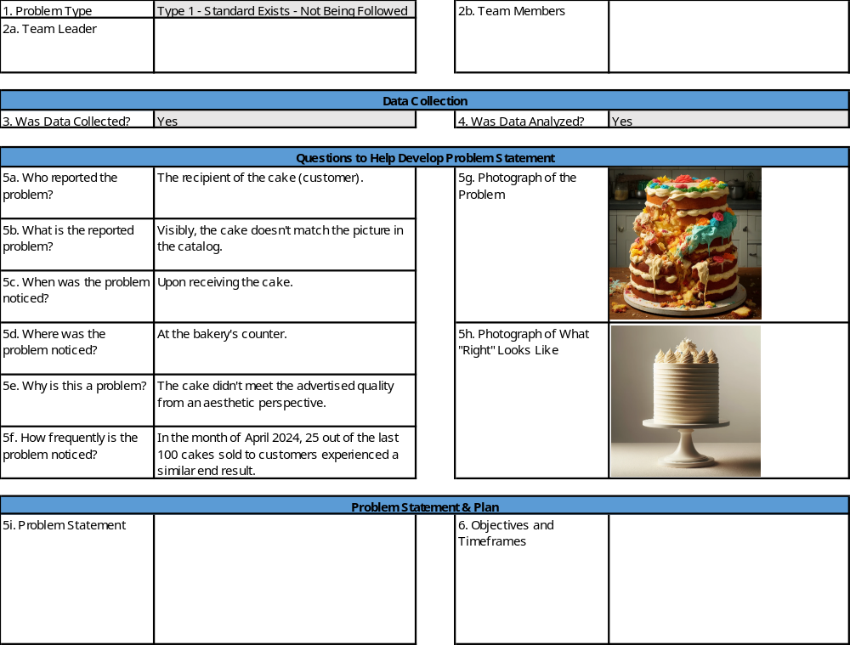
Problem-Solving Process

Slide 62
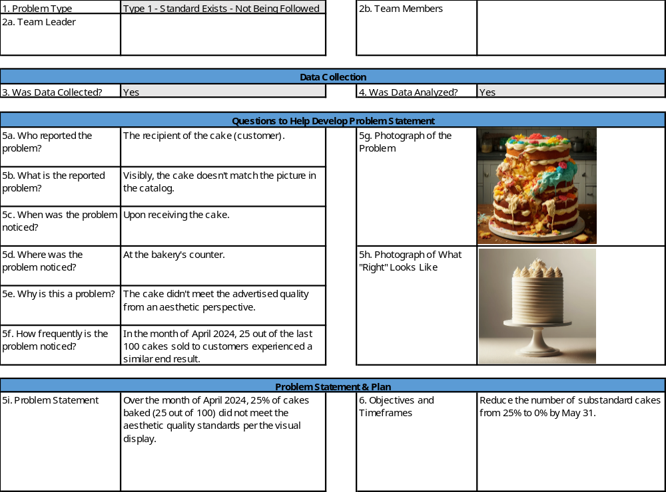
Problem-Solving Process

Slide 63
Problem-Solving Process
LHC Problem-Solving Process
Determine Root Causes
Develop
Problem Statement(s)
9
Determine
Type 0-1-2
5
1
Objective Not Met
Monitor Countermeasure Effectiveness via KPIs
13
Develop Countermeasures
Develop
Objectives and Timeframes
10
Select Cross Functional Team
6
2
Objective Met
Freeze Standard
Incorporate Into
Daily Management
14
Identify
Customer - Supplier Relationships
7
Develop Action Plan
Collect Data
11
3
Continue Kaizen
Analyze Data
4
Temporary Countermeasures
(If Needed)
8
Execute Action Plan
& Document New Process
12
Key:
Plan
Do
Check
Act

Slide 64
7. Identify Customer-Supplier Relationships
Problem-Solving Process
Definition
Purpose
Examples
An outline of all parties involved upstream and downstream of the problem.
Customers: those affected by the problem.
Suppliers: those who provide inputs into the process.
To understand how the flow of information, materials, and services contributes to the problem and to foster collaboration.
Customers:
  External customers: clients.
  Internal customers: the next process.
Suppliers:
  External suppliers: raw material suppliers.
  Internal suppliers: IT team.
Notes:
Ask: Why do we want to know these relationships?

Slide 65
Customer-Supplier Relationships
Problem-Solving Process
Supplier:
Rusted steel
Business:
Uses rusted steel in product
Customer:
Complains about product quality
Problem Source
Problem Identified

Slide 66
Problem-Solving Process
LHC Problem-Solving Process
Determine Root Causes
Develop
Problem Statement(s)
9
Determine
Type 0-1-2
5
1
Objective Not Met
Monitor Countermeasure Effectiveness via KPIs
13
Develop Countermeasures
Develop
Objectives and Timeframes
10
Select Cross Functional Team
6
2
Objective Met
Freeze Standard
Incorporate Into
Daily Management
14
Identify
Customer - Supplier Relationships
7
Develop Action Plan
Collect Data
11
3
Continue Kaizen
Analyze Data
4
Temporary Countermeasures
(If Needed)
8
Execute Action Plan
& Document New Process
12
Key:
Plan
Do
Check
Act

Slide 67
8. Temporary Countermeasures (If Needed)
Problem-Solving Process
Definition
Purpose
Examples
Immediate actions that are taken to stabilize the situation temporarily while seeking a permanent solution.
“Stop the bleeding”
To provide an immediate response to prevent further impact of the problem while a permanent solution is being developed.
Introducing additional quality checks to catch defects until the root cause is discovered and countermeasures are in place.
Employing manual record-keeping as a backup until the new IT system is fully operational.
Notes:
Ask: Who can give me an example of a temporary countermeasure they’ve implemented?
Example:
Airship product to the customer at your cost in order to hit the customer’s delivery requirements.
Sacrifice COST in order to satisfy DELIVERY (SQDC).

Slide 68
Exercise: Develop Temporary Countermeasure(s)
Problem-Solving Process
Objective
Using the information provided, develop temporary countermeasure(s).
Instructions
Time to Complete
Utilize the information on the problem-solving countermeasure form to develop temporary countermeasure(s).
10 minutes
Deliverable
Temporary countermeasures.

Slide 69
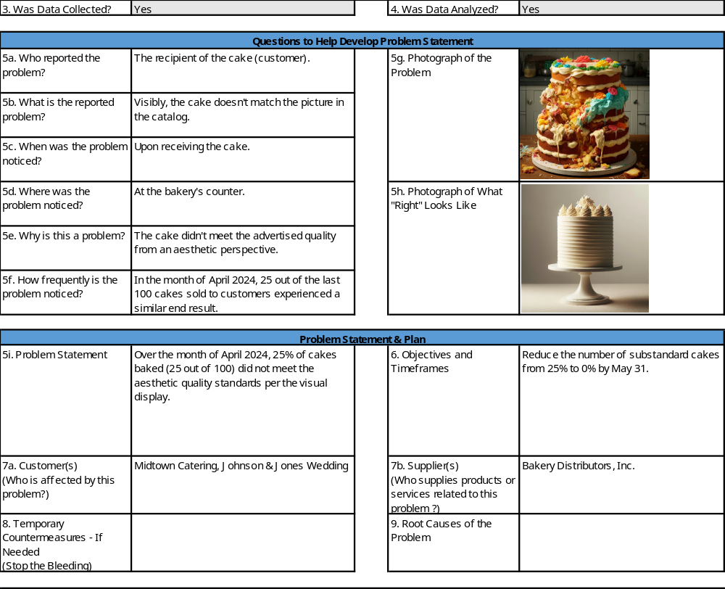
Problem-Solving Process

Slide 70
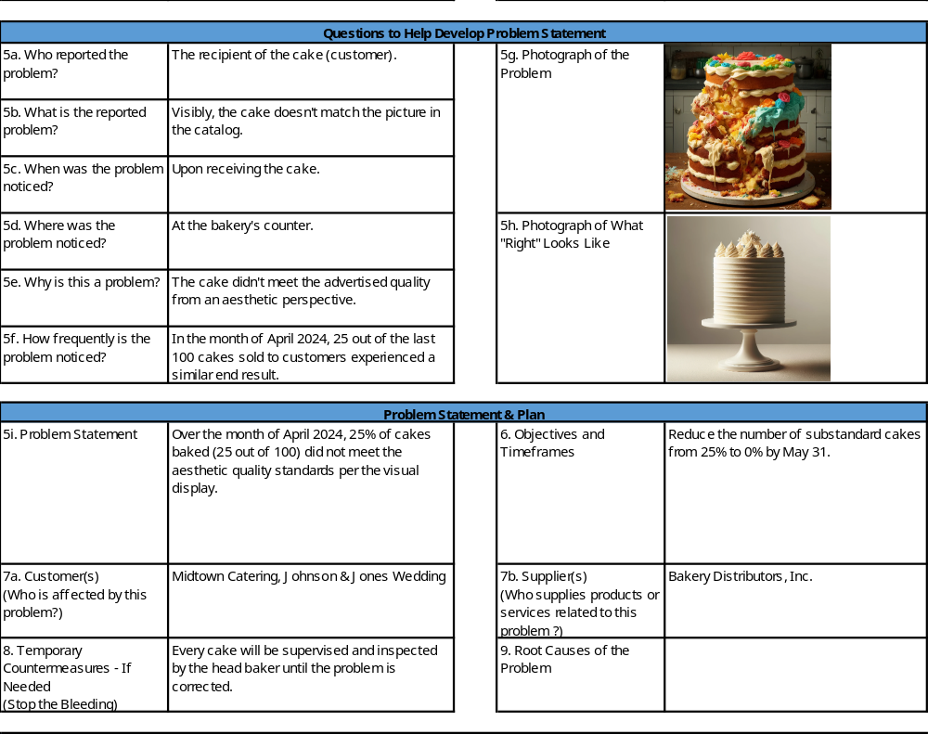
Problem-Solving Process

Slide 71
Problem-Solving Process
LHC Problem-Solving Process
Determine Root Causes
Develop
Problem Statement(s)
9
Determine
Type 0-1-2
5
1
Objective Not Met
Monitor Countermeasure Effectiveness via KPIs
13
Develop Countermeasures
Develop
Objectives and Timeframes
10
Select Cross Functional Team
6
2
Objective Met
Freeze Standard
Incorporate Into
Daily Management
14
Identify
Customer - Supplier Relationships
7
Develop Action Plan
Collect Data
11
3
Continue Kaizen
Analyze Data
4
Temporary Countermeasures
(If Needed)
8
Execute Action Plan
& Document New Process
12
Key:
Plan
Do
Check
Act

Slide 72
9. Determine Root Causes
Problem-Solving Process
Definition
Purpose
Examples
The underlying factors that are contributing to the existence of the problem.
To dig deeper beyond symptoms to uncover the underlying reasons for the problem to prevent recurrence.
Applying the 5 Whys method to trace back the source of material defects to a vendor.
Root cause analysis reveals that inadequate training is leading to operator errors.
Notes:
Ask:

Slide 73
Importance of Root Cause Analysis
Problem-Solving Process
To solve a problem, you must first recognize and understand what is causing the problem.
A root cause is the most basic reason for an undesirable condition or problem.
  If the real cause of the problem is not identified, then you are merely addressing the symptom, and the problem will continue to exist.
Root cause analysis is the process of identifying cause factors using a structured approach with techniques designed to provide a focus for identifying and resolving problems.

Slide 74
Example of Identifying Root Cause Analysis
Problem-Solving Process
The following is an example of how identifying the root cause of a problem is critical to ensuring that it does not return. It is also an example of how root causes are often linked to changes:
  A large refrigerator manufacturer noticed scratches on the outer pre-painted panels of its products. The scratches were as long as 2-3 inches and down to the bare metal.

Slide 75
Example of Identifying Root Cause Analysis
Problem-Solving Process
Incomplete Problem-Solving Approach
Complete Problem-Solving Approach
The process of building the product required that the panels be injected with foam for insulation on large machines with steel fixtures. Because these fixtures were the only non-human objects in contact with the panels, when the problem initially developed, the fixtures were immediately considered the cause.
The company’s initial conclusion was that the surfaces of the fixtures were too rough, which led to scratches. The fixtures were buffed and polished and the problem went away for a while, but eventually resurfaced.
When the problem resurfaced, the panels were taken in for a closer look at the scratches. Inspectors noticed that at the end of most of the scratches was a small round glass bead.
The only place glass of that sort was used in the product was the sound-deadening mat at the bottom of the unit. However, the mats were installed after the unit was near completion at the far end of the plant.
This time, using a complete Problem-Solving approach, the manufacturer investigated the mats and what had changed. The manufacturer had changed an internal process, causing the formation of these loose beads in the mat. When in the plant and being handled, the loose beads would become suspended in the air, and eventually, some would attach to the foaming fixtures. Those beads on the fixture would lead to scratches on the panels. To resolve the problem, the glass mat supplier was forced to correct the process, and the root cause of the problem was eliminated.

Slide 76
Structured Approach
Problem-Solving Process
Step 1: Review and Update Problem Statement
Step 2: Use Tools to List all Potential Causes
Step 3: Use Filter to Narrow your List of Potential Causes
Step 4: Verify the Probable Cause

Slide 77
Step 1:
Review and Update Problem Statement
Problem-Solving Process
  Review and Update Problem Statement
Step 1
Review results of containment actions.
  Did containment actions uncover a broader problem than originally thought?
If necessary, change the scope of the problem to what you now know.
  Use Tools to List all Potential Causes
  Use Filter to Narrow your List of Potential Causes
  Verify the Probable Cause

Slide 78
Step 2:
Use Tools to List all Potential Causes
Problem-Solving Process
  Review and Update Problem Statement
Step 2
Problem-Solving Tools:
  Fishbone Analysis
  Pareto Analysis
  5 Why Analysis
  CEDAC
These tools provide the best compromise between ease of use and effectiveness.
Experts, your team and customers can be used for listing potential problem causes.
  Use Tools to List all Potential Causes
  Use Filter to Narrow your List of Potential Causes
  Verify the Probable Cause

Slide 79
Step 3:
Use Filters to Narrow your List of Potential Causes
Problem-Solving Process
  Review and Update Problem Statement
Step 3
Group causes together and narrow the list.
In order to filter causes – have the group answer the following questions for each cause:
  Could this potential cause (or combination of causes) possibly have led to this problem?
  Eliminate “causes” that do not satisfy this question
  Is/Is Not form - compares the listed “probable cause” to the information known on the Is/Is-not form. The best “probable cause” will explain almost all of the Is/Is-not information. Because there may be multiple factors causing a problem, a ‘probable cause’ may not explain everything on the Is/Is-not.
  The tool uses +, - , and ?, which are added to determine the best probable cause
  Use Tools to List all Potential Causes
  Use Filter to Narrow your List of Potential Causes
  Verify the Probable Cause
Notes:
SAY: “It is critical to involve Subject Matter Experts to assist with the listing and filtering of causes.”

Slide 80
Step 4:
Verify the Probable Cause
Problem-Solving Process
  Review and Update Problem Statement
Step 4
Must verify probable cause
  Observation of process
  Testing
If during this process the team finds the problem to be more complex than was originally thought, experimental verification may be required. Tools such as Design of Experiments can be employed to maximize the effectiveness of the experimentation.
  Use Tools to List all Potential Causes
  Use Filter to Narrow your List of Potential Causes
  Verify the Probable Cause

Slide 81
Exercise: Determine Root Cause(s)
Problem-Solving Process
Objective
Using the information provided, determine the root cause(s).
Instructions
Time to Complete
Utilize the information on the problem-solving countermeasure form and to determine the root cause(s).
10 minutes
Deliverable
The root cause(s) of the bakery problem.

Slide 82
Problem-Solving Process

Slide 83

Problem-Solving Process

Slide 84
Problem-Solving Process
LHC Problem-Solving Process
Determine Root Causes
Develop
Problem Statement(s)
9
Determine
Type 0-1-2
5
1
Objective Not Met
Monitor Countermeasure Effectiveness via KPIs
13
Develop Countermeasures
Develop
Objectives and Timeframes
10
Select Cross Functional Team
6
2
Objective Met
Freeze Standard
Incorporate Into
Daily Management
14
Identify
Customer - Supplier Relationships
7
Develop Action Plan
Collect Data
11
3
Continue Kaizen
Analyze Data
4
Temporary Countermeasures
(If Needed)
8
Execute Action Plan
& Document New Process
12
Key:
Plan
Do
Check
Act

Slide 85
10. Develop Countermeasures
Problem-Solving Process
Definition
Purpose
Examples
Countermeasures are specific actions or interventions designed to eliminate or mitigate the root causes of a problem, preventing recurrence and improving process performance.
To directly address and eliminate the identified root causes of a problem. By implementing effective countermeasures, the goal is to reduce or eliminate the impact of the problem on the process or business.
Implement a new quality control check at each stage of the production process to catch defects early.
Introduce a new scheduling system to ensure adequate staffing during peak hours.
Implement an automated inventory monitoring system to trigger reorders when stock levels are low.
Notes:
Ask:

Slide 86
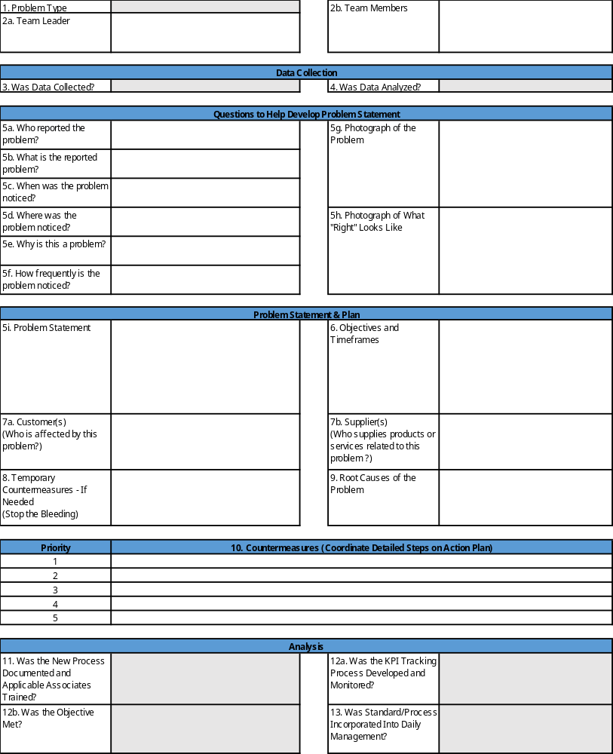
Problem-Solving Countermeasure Form
Problem-Solving Process
This form has been created as a tool that follows the Problem-Solving Process from the previous slide.
Each step in the process is broken out in detail on this form to help guide you to identify the root cause of the problem.

Slide 87
Select the Right Solution
Problem-Solving Process
Objective:
  Reduce or eliminate the root cause identified in previous steps.
3 Steps to Creating Solutions:
  Generate
  Clarify
  Evaluate
Sources of Solutions
Generate Improvement Ideas
Best Practices
Ideas from Other Projects
Brainstorming
Performance Targets
Benchmark Ideas
“Discoveries” During Analysis
Project Goals
Root Causes
Notes:
SAY: “For those that have applied data based decision-making and analysis, identification of root cause is only half the battle.”
SAY: “An excellent way to determine the source of solutions is through the technique of brainstorming.
The process of identifying, evaluating, selecting and developing solutions is rarely linear
Individuals are often required to rethink ideas and reconsider options once the practicality of various solutions is further explored”

Slide 88

Step 1 – Generate: Brainstorm Ideas
Problem-Solving Process
Goal is to generate as many ideas as possible about how each root cause may be eliminated or reduced
Some ideas may affect more than one root cause
Focus on one root cause at a time
  Start with root causes that have the biggest impact on problem statement
Brainstorm
  Best way to generate ideas
Notes:
SAY: “After verifying the root cause, we must begin to generate ideas that ultimately will be the solutions to drive improvement. The more ideas the better! It’s important, however, to become more disciplined (yet creative) with how we brainstorm, as well as how we plan and implement our solutions.”

Slide 89
Brainstorming
Problem-Solving Process
Brainstorming Method – 6 Steps
  Getting Started
  Picking the Right People
  Establish Rules of Engagement
  Capture Every Idea
  Establish a Time Limit
  Organize, Categorize and Evaluate
Notes:
SAY: “Brainstorming is a well known technique for using the subconscious—the most creative portion of the brain—to generate ideas. Its origins can be traced back at least as far as the 1930s, when it was used by Alex Osborn, an advertising executive. Osborn came up with this technique to circumvent his colleagues’ skepticism or resistance to change and thus encourage their ability to think creatively.”

Slide 90
Brainstorming Method
Problem-Solving Process
Getting Started
Pick Right People
Rules of Engagement
Make sure everyone shares same understanding of problem statement and identified root causes
Allow time to mull the problem over as well as be “fresh” for brainstorming session
Early in day (morning) ideal time to hold brainstorming session
Invite people familiar with problem and verified root causes
Select people who represent mixture of professional specialties, backgrounds, and attitudes
The more people selected the longer the brainstorming session will take. Balance should be maintained
Do not criticize
There should be no constraints
Go for quantity
Build on existing ideas

Slide 91
Brainstorming Method (Cont.)
Problem-Solving Process
Capture Every Idea
Establish Time
Limit
Organize, Categorize and Evaluate
Capture the essence of every idea
Word for word is not necessary
Ideas not recorded will probably be lost
Use one or more full-time recorders so you can capture every idea without interrupting flow of the session
Best to let the group know in advance how long the brainstorming session will last
Try to limit each session to 20 minutes
Most creative ideas come when time is limited
Organize all collected ideas when session is complete
Group together repetitive ideas
Place similar ideas into categories and label each

Slide 92

Step 2 – Clarify: Determine Evaluation Criteria
Problem-Solving Process
Determine evaluation criteria by asking yourself the following questions:
What will the best solutions look like?
What are the barriers to implementation?
Which of the best solutions will be the most dramatic? The most visible?
Which will show the fastest results and deliver the most “bang for the buck”?
What and how is your department and others affected?
Which will meet the least resistance and be the easiest to put in place?
Notes:
SAY: “Use all the sources of information you can find to determine what your evaluation criteria should be. Take another look at your customer interview notes. Review your charter. Talk to customers, managers, or other interested stakeholders.”

Slide 93

Step 3 – Evaluate: Apply the Evaluation Criteria
Problem-Solving Process
Solution evaluation process:
Remove show stoppers
Consider organization fit
Develop Solution Selection Matrix
Weight the evaluation criteria
Narrow the list
Evaluate impact
Notes:
SAY: “Multiple techniques and tools exist to help narrow and select the most appropriate solution.”

Slide 94
Step 3 –
Evaluate: Apply the Evaluation Criteria (Cont)
Problem-Solving Process
Determine the criteria that will help your team select the best solution for your situation
Solution | Time Impact | Cost/ Benefit Impact | Level of Difficulty | Total | Rank
Weigh the evaluation criteria if needed to have an unbiased view of each solution.
Notes:
SAY: “You and/or your team may have generated a long list of potential solutions for reducing or eliminating root causes. In order to responsibly evaluate these ideas, the team must establish and agree on a set of evaluation criteria that will be objectively and uniformly applied.”

Slide 95
Exercise: Evaluate Potential Solutions
Problem-Solving Process
Objective
Complete Evaluation Matrix
Instructions
Time to Complete
Divide into small groups (3 – 5).
Given solutions generated from the cake-baking example, complete the evaluation matrix.
30 min
Deliverable
Completed evaluation matrix.
Report key takeaways to group.

Slide 96
Problem-Solving Process
LHC Problem-Solving Process
Determine Root Causes
Develop
Problem Statement(s)
9
Determine
Type 0-1-2
5
1
Objective Not Met
Monitor Countermeasure Effectiveness via KPIs
13
Develop Countermeasures
Develop
Objectives and Timeframes
10
Select Cross Functional Team
6
2
Objective Met
Freeze Standard
Incorporate Into
Daily Management
14
Identify
Customer - Supplier Relationships
7
Develop Action Plan
Collect Data
11
3
Continue Kaizen
Analyze Data
4
Temporary Countermeasures
(If Needed)
8
Execute Action Plan
& Document New Process
12
Key:
Plan
Do
Check
Act

Slide 97
11. Develop Action Plan
Problem-Solving Process
Definition
Purpose
Examples
An action plan is a detailed outline of the steps required to implement the countermeasures, including specific tasks, responsible individuals, timelines, and resources needed.
To ensure the systematic and effective implementation of countermeasures. It provides a clear roadmap for executing the necessary actions, assigning responsibilities, and setting deadlines to achieve the desired outcomes.
Countermeasure: Implement a new quality control check at each stage of production.
  Action Plan:
    Task 1: Train quality control staff on the new procedures.
    Task 2: Update the production schedule to include quality control checks.
    Task 3: Monitor the implementation and gather data on defect rates.
Notes:
Ask:

Slide 98
Problem-Solving Process
LHC Problem-Solving Process
Determine Root Causes
Develop
Problem Statement(s)
9
Determine
Type 0-1-2
5
1
Objective Not Met
Monitor Countermeasure Effectiveness via KPIs
13
Develop Countermeasures
Develop
Objectives and Timeframes
10
Select Cross Functional Team
6
2
Objective Met
Freeze Standard
Incorporate Into
Daily Management
14
Identify
Customer - Supplier Relationships
7
Develop Action Plan
Collect Data
11
3
Continue Kaizen
Analyze Data
4
Temporary Countermeasures
(If Needed)
8
Execute Action Plan
& Document New Process
12
Key:
Plan
Do
Check
Act

Slide 99
12. Execute Action Plan & Document New Process
Problem-Solving Process
Definition
Purpose
Examples
A record of the new process and the educational materials used to train staff on these changes.
Process should be documented in a visual format whenever possible.
To formalize the changes in processes and ensure all relevant personnel are proficient in the new methods.
Creating a new standard operating procedure for machine setup and conducting hands-on training for operators.
Updating the customer service script and providing workshops for representatives.
Notes:
Ask:

Slide 100

Process Defined
Problem-Solving Process
A systematic series of activities directed toward achieving an end result in which one or more inputs are acted upon to create one or more outputs.
Applies to products, services, information, etc.

Slide 101
10 Rules of a Process
Problem-Solving Process
If a process is not documented, it is not a process.
Visibly display processes.
Processes should have job instructions, roles, and responsibilities.
Processes need to be trained with periodic refreshers.
Products or information should have a clear path.
Ensure quality before passing on to the next process or customer.
Eliminate waiting.
Apply kaizen to improve processes.
Monitor with KPIs.
Improve processes with Kaizen/PDCA.
Notes:
Say:
If a process is not documented, it is not a process. The end result will be poor quality and customer service, variation, and high costs.
All processes, whether they be product, administrative, or informational, should have the framework to be displayed visually.
Each process step should have detailed job instructions, with assigned roles and responsibilities, developed in collaboration with front-line associates. When possible, visual documentation is preferred over written.
All associates need to be properly trained on the process, with periodic refresher training to assure compliance with SOPs.
Throughout the process, all movement of a product, document, or information should have a clear, direct path with no ambiguities.
Assure the quality of the product or service before passing it on to the next process/customer.
Waiting waste is perhaps the most detrimental waste in a process, and it can have many root causes, such as poor quality, batch and queue operations, improper loading of equipment/operators to TAKT Time, etc.
Processes need to be evolved through rigorous application of Kaizen.
Key Performance Indicators (KPIs) should be developed to track the following:
Adherence to the process
Process outcomes
Apply the Deming Cycle (PDCA) to continually monitor and correct deviations from the process.

Slide 102
Lego Boat Exercise
Problem-Solving Process
Objective
Construct a Lego boat with the provided instructions.
Instructions
Time to Complete
Select four individuals from the group to participate in building a Lego boat.
Participant 1: Will build the Lego boat using traditional Lego-style visual instructions.
Participant 2: Will build the Lego boat using text-based instructions.
Participants 3 and 4: Start timer for participants 1 and 2, respectively.
When a builder is complete, the instructor will check the quality of the product. If it is not correct, they must re-do it.
Participants 3 and 4: Record the final time for your builder and report back to the group.
10 minutes
Deliverable
A complete Lego boat as described by the instructions provided.
Notes:
Say: Both participants will have the exact same Lego bricks. The quantity, sizes, colors, etc. are all the same. Participant 1 will use visual instructions with no text at all. Participant 2 will have text-only instructions. Both participants are to follow the instructions on their sheets as they are provided and cannot look at each other while working.
Before beginning the exercise, have each participant empty the contents of their bag on the table in front of them and ensure that all of the pieces are separated and that they have the correct pieces according to the contents list in their instructions.
It is best to have the two participants sit back-to-back. If the room does not allow for that, put something (or someone) between them so they can’t see each other.

Slide 103

Food for Thought
Problem-Solving Process
Toyota gets BRILLIANT results with ORDINARY people running BRILLIANT processes.

Slide 104
Problem-Solving Process
LHC Problem-Solving Process
Determine Root Causes
Develop
Problem Statement(s)
9
Determine
Type 0-1-2
5
1
Objective Not Met
Monitor Countermeasure Effectiveness via KPIs
13
Develop Countermeasures
Develop
Objectives and Timeframes
10
Select Cross Functional Team
6
2
Objective Met
Freeze Standard
Incorporate Into
Daily Management
14
Identify
Customer - Supplier Relationships
7
Develop Action Plan
Collect Data
11
3
Continue Kaizen
Analyze Data
4
Temporary Countermeasures
(If Needed)
8
Execute Action Plan
& Document New Process
12
Key:
Plan
Do
Check
Act

Slide 105
13. Monitor Countermeasure Effectiveness via KPIs
Problem-Solving Process
Definition
Purpose
Examples
Metrics and procedures used to assess the impact of implemented solutions.
To track the performance of the implemented solutions against objectives and adjust as needed for continuous improvement.
Measuring the defect rate weekly post-implementation to ensure sustained improvement.
Monitoring customer satisfaction scores after a new service protocol is introduced.
Notes:
Ask:

Slide 106
Sustain the Improvements
Problem-Solving Process
Perhaps the most important step of all Problem-Solving activities is that actions are put in place to ensure that:
  The solutions are, in fact, preventing the problem from recurring.
  The solutions themselves are being followed for the long term.
Step 5, Sustain the Improvements, will cover effective strategies that target both

Slide 107
Key Considerations for Sustaining Improvements
Problem-Solving Process
Establish Process
Ensure Roles
Update Metrics
Establish a process for updating and reviewing improvement actions.
Not uncommon for reviews to be held daily at first, then weekly as the improvements are implemented.
Ensure that clear roles and responsibilities are defined and assigned.
Not only for the Problem-Solving team but also for individuals who will use the new and improved process.
That which does not get measured does not improve.
Update daily/weekly to show progress.
Tell us the health of our process and how we are doing against our goals.

Slide 108
Key Considerations for Sustaining Improvements
(Cont)
Problem-Solving Process
Include Others
Standardize Processes
Ensure Improvements
Include other associates as needed.
Train all who are involved on various shifts and implement a communication plan as needed.
Standardize improved processes for other similar business needs.
Apply these improvements to other areas.
Leverage improvements across the business to maximize results.
Ensure improvements are sustainable and well documented.
Ensure there is a process owner who manages the ongoing metrics that indicate the health of the process.
Continue the PDCA Cycle when targets are missed or as part of the continuous improvement of the process.

Slide 109
Plan Do Check Act Module – Continuous Cycle
Problem-Solving Process
In Sustaining Improvements, the PDCA Cycle is implemented every time we visit our metrics and need to create countermeasures.
Begin with grasping the situation, then follow with the PDCA sequence.
Continuous improvement never ends.
Grasp the
situation
ACT
PLAN
CHECK
DO

Slide 110
Exercise: Sustain the Improvements
Problem-Solving Process
Objective
Develop Methods to Sustain Improvements
Instructions
Time to Complete
Divide into small groups (3 – 5).
Given evaluated solutions from the cake baking example, develop methods to sustain improvements.
30 min
Deliverable
Completed list of methods for Sustaining improvements.
Report key takeaways to group.

Slide 111
Problem-Solving Process
LHC Problem-Solving Process
Determine Root Causes
Develop
Problem Statement(s)
9
Determine
Type 0-1-2
5
1
Objective Not Met
Monitor Countermeasure Effectiveness via KPIs
13
Develop Countermeasures
Develop
Objectives and Timeframes
10
Select Cross Functional Team
6
2
Objective Met
Freeze Standard
Incorporate Into
Daily Management
14
Identify
Customer - Supplier Relationships
7
Develop Action Plan
Collect Data
11
3
Continue Kaizen
Analyze Data
4
Temporary Countermeasures
(If Needed)
8
Execute Action Plan
& Document New Process
12
Key:
Plan
Do
Check
Act

Slide 112
14. Freeze Standard Incorporate Into Daily Management
Problem-Solving Process
Definition
Purpose
Examples
The new protocol is established as the norm and integrated into regular operations.
Embedding the standard into regular operations and monitoring adherence to ensure long-term sustainability.
To ensure that improvements are maintained over time, preventing regression to old habits or practices. By incorporating the standard into daily management, it becomes part of the organization's routine, ensuring continuous compliance and facilitating ongoing improvement.
Customer Service:
  Standard: A new script for handling customer complaints.
  Incorporation: Training all customer service representatives and incorporating the script into the performance evaluation criteria.
Administrative Procedures:
  Standard: A new process for document approval within 24 hours.
  Incorporation: Implementing the process in the workflow management software and monitoring compliance through regular audits.
Notes:
Ask:

Slide 113
Summary
Introduction to
Problem-Solving
Problem-Solving Tools
Problem-Solving Process
Summary
Objectives:
Effective Problem Description:
  Collect data using graphical and quantitative tools.
  Write clear, specific problem statements based on data.
Root Cause Analysis:
  Use tools like Fishbone Analysis, Pareto Analysis, and 5 Why Analysis.
  Involve Subject Matter Experts to verify root causes.
Implement and Monitor Countermeasures:
  Develop and document short-term and long-term countermeasures.
  Use the Countermeasure Form to track actions and results.
Sustain Improvements:
  Establish processes for reviewing and updating improvements.
  Standardize and document improved processes for sustainability.
Notes:
DO: Review the Summary that will be discussed in this section.

Slide 114
Summary
Summary
Depending on the complexity of the problem, a problem may be assigned to an individual or a team for resolution.
In order to effectively describe the problem, it is necessary to collect data using graphical, quantitative tools.
When writing the current condition, (1) avoid trying to identify potential solutions, (2) effectively scope the problem, and (3) avoid writing vague statements that are easily misunderstood.
A good problem statement describes in specific terms what the data reveals from the data collection effort. It should also describe the target to be achieved based on customer requirements.
The Countermeasure Form is a tool that captures the output of the problem-solving thinking process and is used to track and manage the results of the problem-solving actions.

Slide 115
Summary (Cont.)
Summary
Containment, or the development of short-term countermeasures, is a natural response to problems.
To be successful, containment must be organized and conducted correctly.
  Isolate the problem.
  Document all actions.
  Review the scope of the containment actions.
  Be prepared to treat the problem as a formal project.
  Constantly monitor the effectiveness of the containment plan.
Use the Countermeasure Form to document and manage
the containment actions.

Slide 116
Summary (Cont.)
Summary
Finding the root cause is a structured technique that focuses on finding the causes of a problem so that the right solution can be put in place to eliminate the problem.
Use the following tools together in your root cause analysis: Fishbone Analysis, Pareto Analysis, 5 Why Analysis.
It is critical to involve Subject Matter Experts to assist with the listing and filtering of causes.
Verify the root cause or causes through observation and testing as needed. For more complex problems, tools such as Design of Experiments may be required.
The Countermeasure Form tracks and documents the flow of
problem-solving thinking.

Slide 117
Summary (Cont.)
Summary
Idea generation should be based on reducing or eliminating root causes found during analysis. The three steps to idea creation are Generate, Clarify, and Evaluate.
An excellent way to determine the source of solutions is through the technique of team brainstorming, which allows team members to build on one another’s ideas.
There should be no criticism and no constraints when brainstorming. Go for quantity while building on existing ideas.
Determine the criteria which will help your team to select the best solution for the situation. Multiple techniques and tools exist to help reduce and select the most appropriate solution.

Slide 118
Summary (Cont.)
Summary
In order to effectively sustain the improvements that were gained from the implemented solutions, the following are key considerations to follow:
  Establish a process for updating and reviewing improvement actions.
  Ensure that clear roles and responsibilities are defined and assigned.
  Update metrics daily/weekly to show progress.
  Include other associates as needed.
  Standardize improved processes for similar business needs.
  Ensure improvements are sustainable and well-documented.
The Plan Do Check Act (PDCA) Model is a cycle. The only way for problem resolution to be successful is through the rigorous employment of this cycle. Continuous improvement never ends.

Slide 119
Pareto Diagram
Definition
Purpose
Examples
A type of bar chart that displays the frequency of occurrences by category, ordered from highest to lowest.
Based on the Pareto principle (also known as the 80/20 rule), which suggests that roughly 80% of the effects come from 20% of the causes.
Helps focus efforts on the areas that will have the greatest impact on improving a system.
Customer Complaints in a Call Center:
  Analyzing types of customer complaints received.
Software Bug Tracking:
  Categorizing types of bugs reported in a software development project.
Lost Sales Quotes:
  Can be tracked by customer, salesman, product, region, etc.
Immigration Data:
  Track by country, gender, religion, etc.
Notes:
Ask:

Slide 120
Pareto Diagram Example
What is your takeaway from this example?
Notes:
Defects by day of the week
The Pareto Diagram illustrates the frequency of cake defects occurring on different days of the week. The X-axis represents each day of the week, ordered from highest to lowest number of defects. The Y-axis on the left shows the number of defects, while the Y-axis on the right shows the cumulative percentage of defects. Bars represent the count of defects for each day, with a line graph superimposed to show the cumulative percentage. This chart helps the end user identify which days are contributing most to the defects, highlighting the "vital few" days that need the most attention.

Slide 121
Pareto Charts
Pareto Diagram
Transform information from a Check Sheet into a Pareto Chart
Pareto may reveal:
  What types of problems are most prevalent and/or most costly
  Where most of the problems are occurring
Provides the basis for setting priorities or corrective action steps
A Pareto Chart is not a stand-alone tool for priority setting. You need to determine the priority keeping the customer in mind
Separates vital few from trivial many; organizes data from highest value to lowest
When you need to display the relative importance of all conditions in order to:
  Choose the starting point for Problem-Solving
  Monitor success
  Identify the basic cause of a problem
Notes:
SAY: “A Pareto Chart is a graphic display of data shown in order from highest (frequency, cost, etc.) to lowest (frequency, cost, etc.). Pareto Charts help to determine which problem to attack first. You will still need more detail to describe the problem and find the cause.”
SAY: “CAUTION - A Pareto Chart is not a stand-alone tool for priority setting. For example, the highest frequency of errors or problems may not account for the highest cost. You need to determine the priority, keeping the customer in mind.
For instance, in the ‘Plant Cleaning Example’ a Pareto Chart could show:
What types of problems are most prevalent, and/or most costly
Where most of the problems are occurring
Now you have the basis for setting priorities on corrective action steps.”

Slide 122
Origin of Pareto Analysis
Pareto charts originated with the famous economist Vilfredo Pareto.
The Pareto Principle, also commonly referred to as the 80/20 rule:
  Pareto first observed that 80% of the land in Italy was owned by 20% of the population. Vilfredo later discovered many other manifestations of the 80/20 rule. For example, he observed that 80% of his garden peas were produced by 20% of the peapods.
Other examples of 80/20 rule:
  80% of process defects arise from 20% of the process issues.
  80% of the process lead time is caused by 20% of the information flow inaccuracies.

Slide 123
When to use Pareto Analysis
Focuses on data and the examination of facts.
Highly useful in the initial data collection as well as validation of the true problem statement for Problem-Solving.
Best used in combination with other Problem-Solving tools to narrow down to the root cause of a problem.
Additionally Pareto charts are used quite effectively to monitor performance of sustained changes over time in order to drive future prioritization for Problem-Solving opportunities.

Slide 124
Mechanics of Creating a Pareto Chart
List problem sources and their frequencies.
Plot data in descending order of frequency.
Add cumulative percentage line to identify the most impactful problems.
Notes:
SAY: “A best practice is to plot a percent line, this will illustrate the 80/20 rule while helping to recognize you have reached root cause level”

Slide 125
Mechanics of Creating a Pareto Chart
Identify Potential Problem Sources:
  Create a list of all potential problem sources (e.g., defects, issues) you want to analyze.
Collect Data:
  Record the frequency of each problem occurring within a fixed period of time.
  Calculate the cost associated with a single occurrence of each problem.
  Determine the total cost for the period by multiplying the frequency by the cost per occurrence.
Organize the Data:
  Create a table that includes the problem sources, their frequencies, the cost per occurrence, and the total cost for the period.
  Sort the table by frequency, from highest to lowest.
Prepare the Chart:
  On the x-axis, list the problem sources from the sorted table.
  On the left y-axis, indicate the frequency of occurrences.
  On the right y-axis, indicate the cumulative percentage of total occurrences.
Plot the Data:
  Create vertical bars to represent the frequency of each problem source, starting with the highest frequency on the left.
  Add a cumulative line to show the cumulative percentage of total occurrences, moving from left to right.
Analyze the Chart:
  Identify the "vital few" problem sources that constitute the majority of occurrences.
  Focus improvement efforts on these key areas to achieve the most significant impact.
Notes:
SAY: “A best practice is to plot a percent line, this will illustrate the 80/20 rule while helping to recognize you have reached root cause level”

Slide 126
Pareto Chart Example
Notes:
NOTE: Example of a pareto chart.

Slide 127
Pareto Chart Review
Frequency may not be indicative of magnitude, instead cost may be more meaningful.
It is important to identify in advance the customer’s priorities, in order to use the data to make decisions.
Notes:
NOTE: Example of a pareto chart.

Slide 128
Benefits and Limitations of Pareto Analysis
Benefits
Limitations
Separates vital problems from trivial few problems to assist with choosing a starting point for Problem-Solving.
Helps to provide focus as to where the biggest impact will be generated.
The first level of Pareto Charts may only reveal a symptom of a problem or not enough information to be actionable and may require several charts to reach a root cause level.
Pareto Charts help to determine which problem to attack first. You will still need more detail to describe the problem and find the cause.

Slide 129
Problem-Solving Tools: Fishbone Analysis
Objectives:
Define Fishbone Analysis
State the purpose and understand the origin of Fishbone Analysis
Discuss the benefits and limitations of Fishbone Analysis
Explain when the Fishbone Analysis is used during the Problem-Solving process
List the 6-M’s and demonstrate how a Fishbone Diagram is constructed
Describe how the Fishbone Diagram is used to solve complex problems
Apply Fishbone Analysis to determine where to focus Problem-Solving efforts
Notes:
DO: Review section objectives.

Slide 130
Definition of Fishbone Analysis
A fishbone diagram proves a structured way of looking at the cause and effect nature of problems.
It is also referred to as a cause & effect diagram.
The design of the diagram looks like the skeleton of a fish

Slide 131
Purpose and Origin of Fishbone Analysis
Provides mechanism for team to team to identify, explore, and graphically display, in increasing detail, all the possible causes related to a problem in order to identify root cause(s)
Invented by Dr. Jaoru Ishikawa while working in the Japanese ship yards as a quality control statistician
Also referred to as the Ishikawa Diagram
Illustrates the connection between problems and their impacts.

Slide 132
When to Use Fishbone Analysis
Within the Problem-Solving Process, the Fishbone Diagram allows you to explore problems and their origins through brainstorming in order to choose a starting point.
Fishbone Analysis enables larger Problem-Solving efforts by supporting data collection and root cause identification.
Benefits:
  Allows team to identify all possible root causes of a problem
  Allows teams to see the problem from the perspective of it’s impact through a graphical representation
Limitations:
  Must be used in conjunction with other tools in order to solve complex problems

Slide 133
Fishbone Analysis Process
Generate causes needed to build diagram
  By brainstorming
  Through a Check Sheet
Construct the actual diagram
Interpret to find the most basic causes of the problem
  Look for causes that appear repeatedly
  Reach team consensus
  Gather data to determine the relative frequency of the different causes
Notes:
SAY: “Use the categories just mentioned on the previous slide as sources for brainstorming when you start to run out of ideas.”

Slide 134
Mechanics of Constructing Fishbone Diagram
Start with straight line leading directly to problem
Draw lines at 45 degree angles off of the "backbone" of the fish. At the end of these lines you will put in different categories
The problem or issue should be the main purpose of creating the fishbone diagram. Insert the problem/issue in the "head of the fish."
Every "bone" should lead directly to the problem that is identified
Next, label categories above each of the bones of the fish.
Use brainstorming to identify the factors under each category affecting the problem/issue and/or effect being studied
Repeat this procedure for each category
Categories
Problem
Notes:
SAY: “A Pareto Chart is a graphic display of data shown in order from highest (frequency, cost, etc.) to lowest (frequency, cost, etc.). Pareto Charts help to determine which problem to attack first. You will still need more detail to describe the problem and find the cause.”
SAY: “CAUTION - A Pareto Chart is not a stand-alone tool for priority setting. For example, the highest frequency of errors or problems may not account for the highest cost. You need to determine the priority, keeping the customer in mind.
For instance, in the ‘Plant Cleaning Example’ a Pareto Chart could show:
What types of problems are most prevalent, and/or most costly
Where most of the problems are occurring
Now you have the basis for setting priorities on corrective action steps.”

Slide 135
Fishbone Diagram Categories
6 M’s (Machines, Materials, Methods, Manpower, Measurement, Mother Nature)
  Most popular (when dealing with products)
Other commonly used categories
  Policies, procedures, people and plant when dealing with administrative areas

Slide 136
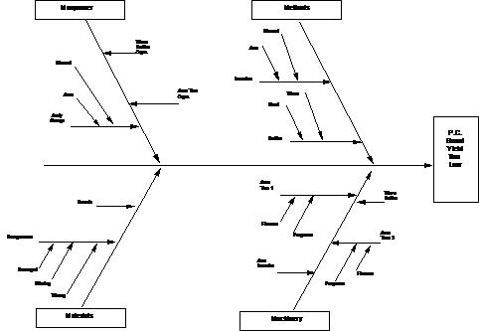
Developmental Hints
Try not to go beyond the area of the group in order to minimize frustration
If ideas are slow in coming, use the major cause categories as catalysts
Use as few words as possible
Make sure everyone agrees completely on the problem statement.

Slide 137
Exercise: Fishbone Analysis
Objective
Develop a Fishbone Diagram for a Given Problem
Instructions
Time to Complete
Divide into small groups (3 – 5). Identify a problem and write a problem statement.
Using the 6 M’s, develop a Fishbone Diagram to identify root causes for the problem.
Based on the diagram, identify where to focus
Problem-Solving efforts.
30 min
Deliverable
Completed Fishbone Analysis. Report key takeaways to group
Notes:
DO: Pass out yellow and blue cards to complete the CEDAC exercise. Build the fishbone chart on chartpaper on the wall and complete with the class.
Brainstorm all facts on yellow cards or post-it notes of what is causing the problem or standing in the way of the target.
Brainstorm solutions on blue cards or post-it notes and place them next to their corresponding yellow fact card.
NOTE: For purposes of the exercise (and time) you can stop the exercise at this point and explain from this point on we would prioritize the actions and then take action on the cards.

Slide 138
5 Whys
Definition
Purpose
Examples
A root cause analysis method that involves asking "Why?" five times, or as many times as necessary, to peel away the layers of symptoms and reach the underlying cause of a problem.
Must be used in conjunction with other Problem-Solving tools
Must have a well-defined problem statement in order to effectively focus the analysis and arrive at the correct root cause.
To systematically drill down into a problem's details and circumstances to ensure that any corrective actions address the fundamental reasons for the issue rather than merely treating its superficial symptoms.
5 Whys help you discover:
  Why the error was made.
  Why the problem happened.
  Why the system failed.
  Why it takes so long.
  Why the error keeps happening.
  Why the error wasn’t detected.
Notes:
Say:
5 Whys are used after potential causes are identified (using other tools such as Pareto or Fishbone Analysis) in order to drill to the root cause.
Symptoms are the part we see, the part on the surface; they are how we know we have a problem.
Problems are the cause of that symptom.

Slide 139
Problem:
The Washington Monument is Disintegrating
Why is the Washington Monument disintegrating?
  The monument is being cleaned with harsh chemicals.
Why is it frequently cleaned with harsh chemicals?
  There is a lot of pigeon poop on the monument.
Why are there a lot of pigeons around the monument?
  Pigeons eat spiders nesting in the monument.
Why are there spiders inside the monument?
  The spiders are nesting inside the monument to catch gnats.
Why are there gnats around the monument?
  The gnats are attracted to artificial light at dusk.
Root Cause:
The artificial light at dusk attracts gnats, which in turn attracts spiders, which then attract pigeons. The pigeon poop causes frequent cleaning with harsh chemicals, leading to the disintegration of the monument.
Possible Solution:
Adjust or reduce the use of artificial lighting at dusk to reduce the attraction of gnats, thereby breaking the chain reaction that ultimately leads to the monument’s disintegration.
Notes:
Ask: Do you think that this problem was solved by one person?

Slide 140
Benefits of 5 Why Analysis
Simple Problem-Solving tool that is easy to use.
Helps to quickly separate symptoms from causes and identify the root cause of the problem.
Aids in determining the relationship between various problem causes.
Fosters and produces teamwork and teaming within the organization.
Guided, team-focused exercise. There are no additional costs.

Slide 141
Mechanics of the 5 Why Analysis
1st Why
2nd Why
Short, concise sentence
Should explain the reason
Don’t try to justify
Write it down, even if obvious
More concise explanation to support the first question
Must ask a full question (ex. Why was the train late?)
Can branch out to several root causes
Okay to follow each with its own set of whys
Notes:
Say: “Even though the discipline is called 5 Why Analysis, its not always necessary to reach 5 before the root cause of a problem is fully explained. It may take more or less than 5 to get to the bottom of a problem. Follow your thought process until you reach an actionable level.”

Slide 142
Mechanics of the 5 Why Analysis (Cont.)
3rd Why
4th Why
Don’t jump to conclusions
Follow regular thought process
Critical for successful transition between the obvious and not-so-obvious
Explore all avenues
Good time to include a Fishbone Analysis and look at the 6 Ms
  Man
  Machines
  Materials
  Methods
  Management
  Measurements

Slide 143
Mechanics of the 5 Why Analysis (Cont.)
5th Why
Will have systemic cause
Most problems in process can be traced here
When addressing a systemic cause, do it across the whole process
Detect areas under the same situation
If you are still dealing with process related causes after reaching 5th Why, you may still need one of two more Whys to reach a systemic cause

Slide 144
Verifying Validity of 5 Why Analysis
Organize data and check for consistency to ensure the root cause is correctly identified.
Must revisit the 5 Why and identify those gaps to fill in the problem.
Check the analysis:
  Description occurred due to the “Fifth Why”. This was caused by the “Fourth Why” mainly because the “Third Why” was allowed by the “Second Why,” and this led to the “First Why.”
If coherent, it will show consistency in the thought process.
Sought outcome of 5 Why exercise is the root cause of a defined problem, not the resolution of the problem itself.

